Slide 1
GIT COMMANDS
Submitted by:
Aleesha Joji
166574

Slide 2
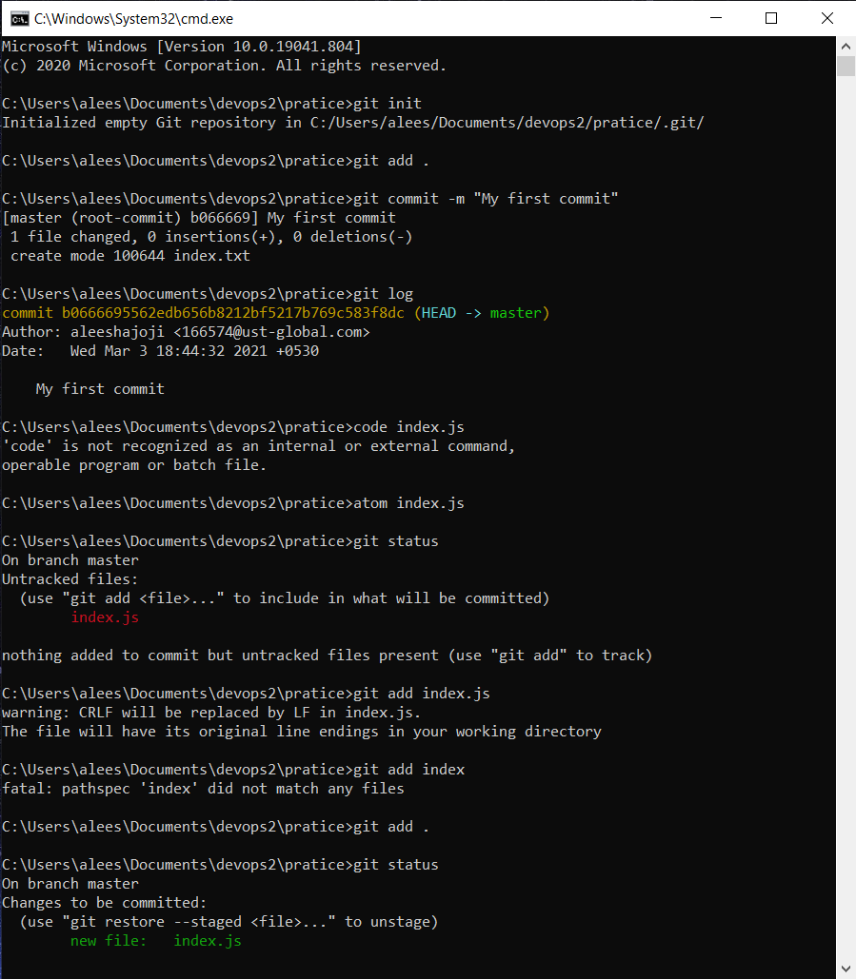
git init-The git init command creates a new Git repository.
git add .-The git add command adds a change in the working directory to the staging area.
git log-The simplest version of the log command shows the commits that lead up to the state of the currently checked out branch.
atom/code index.js- creats an atom window
git status-The git status command displays the state of the working directory and the staging area.
git add index.js-adds the index.txt file
git status-checks the status of the master

Slide 3
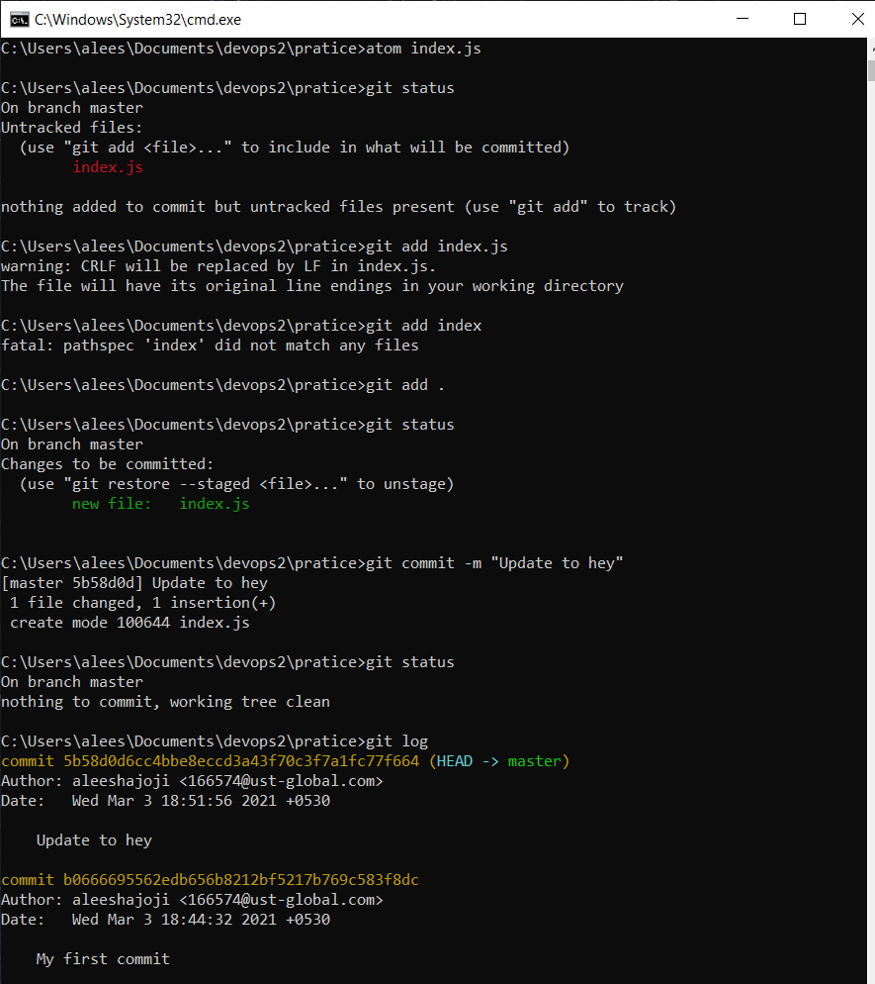
git commit -m “update to hey”-creates a commit, which is like a snapshot of your repository.
git status-
git log-

Slide 4
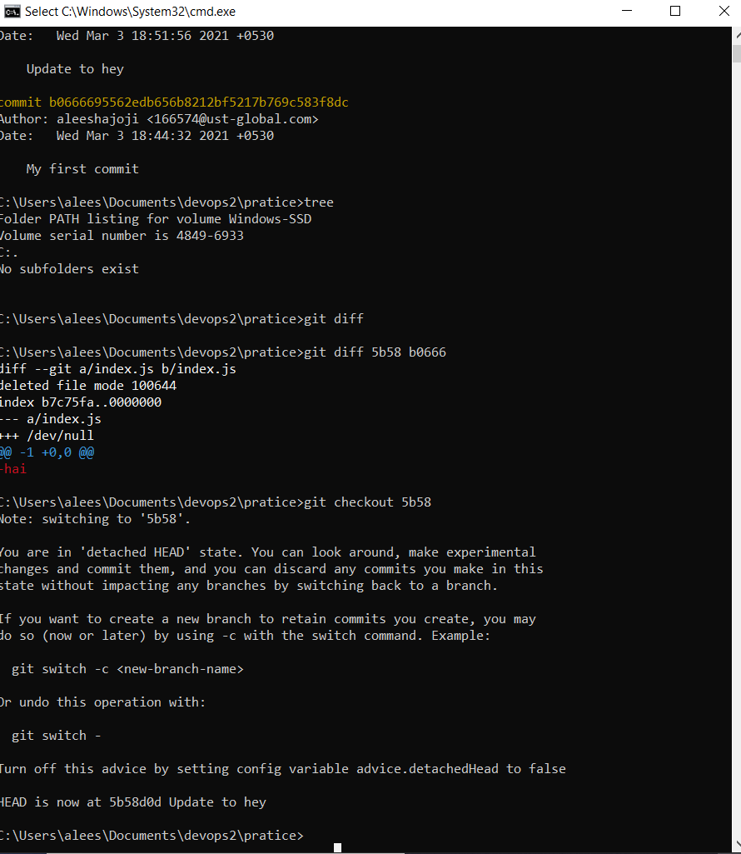
tree-creates a commit, which is like a snapshot of your repository.
git diff-to track the difference between the changes made on a file.
git checkout h1-act of switching between different versions of a target entity.

Slide 5
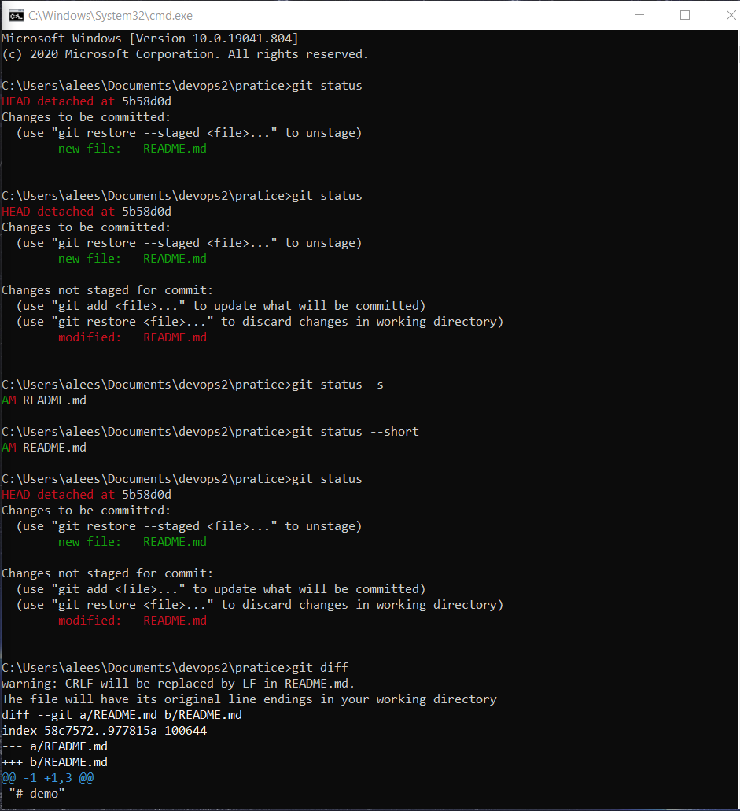
git status-
git status-s:
git status --short
git diff-

Slide 6
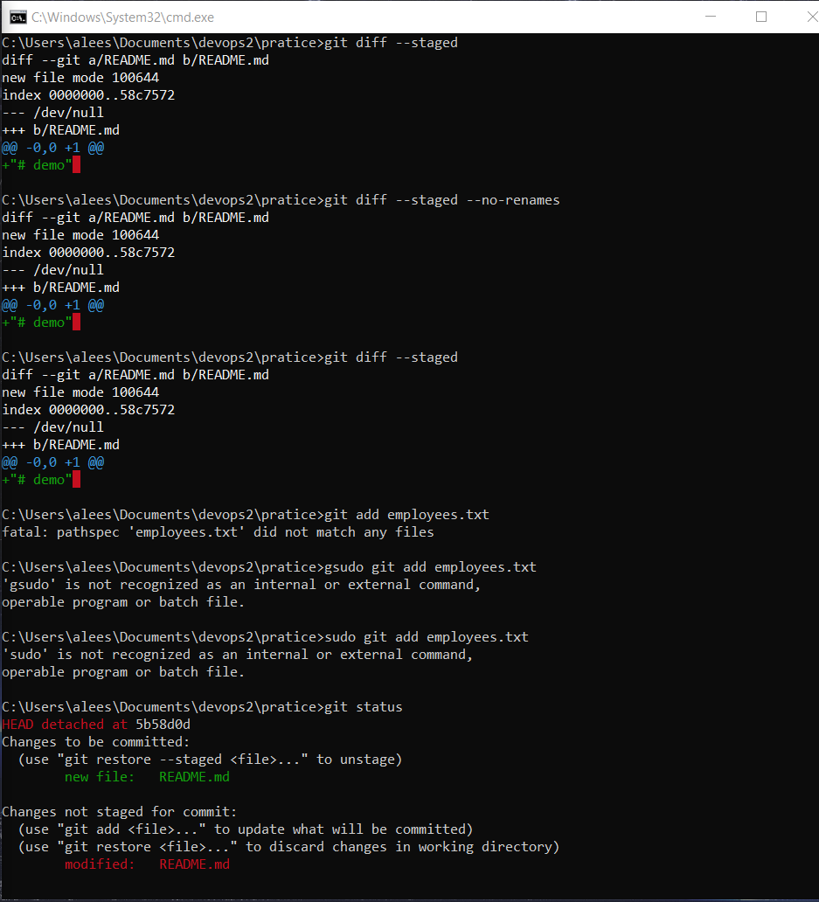
git diff --staged:
git diff --staged --no-renames:

Slide 7
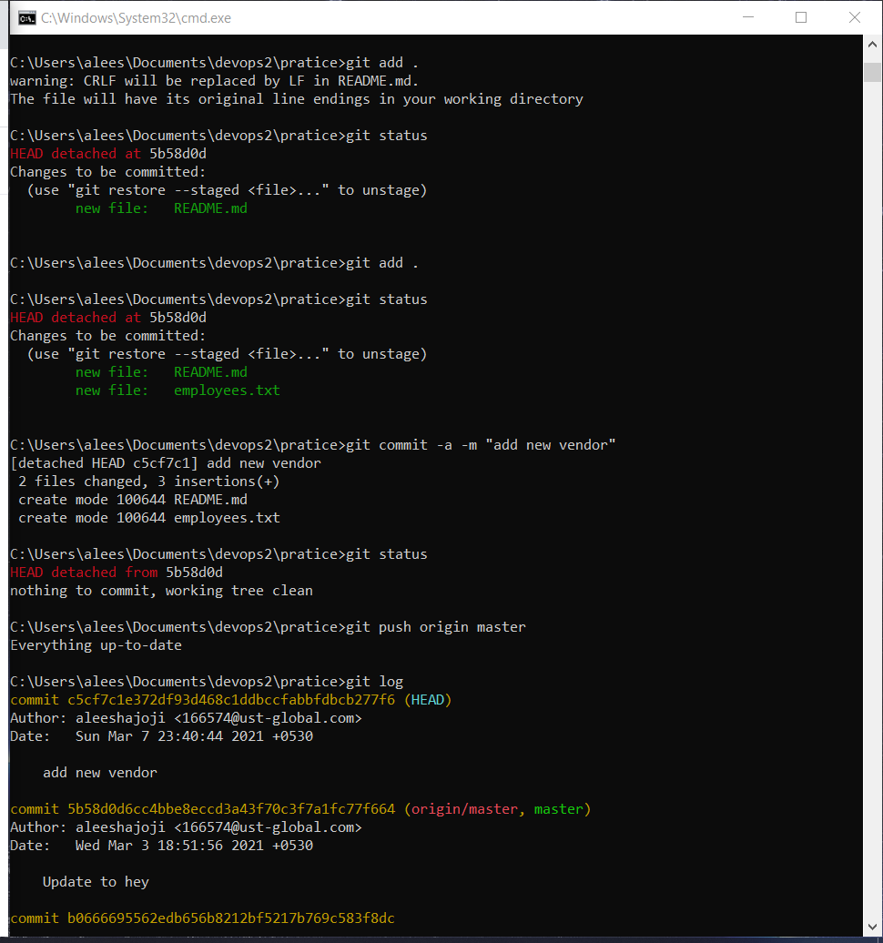
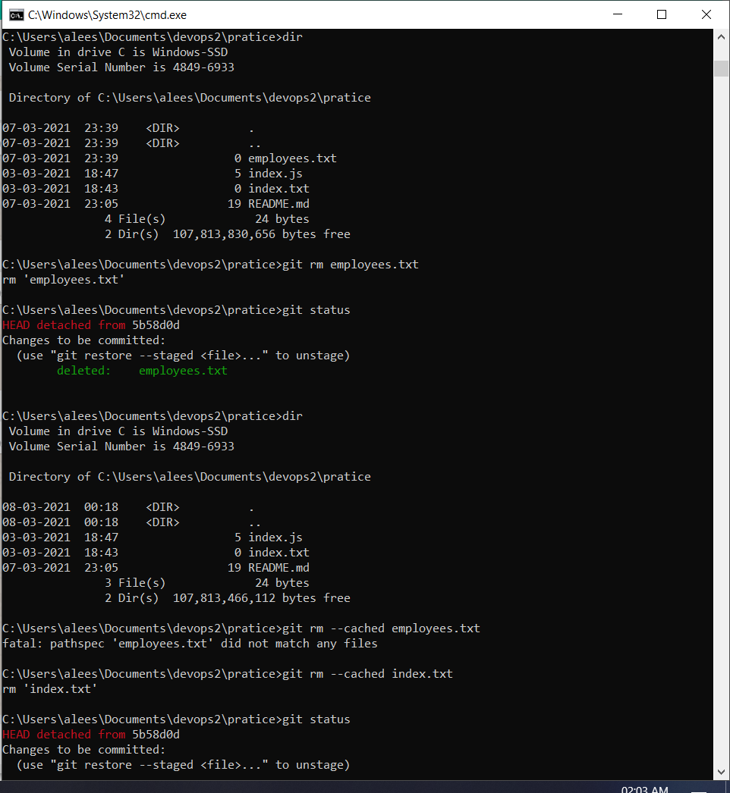

Slide 8
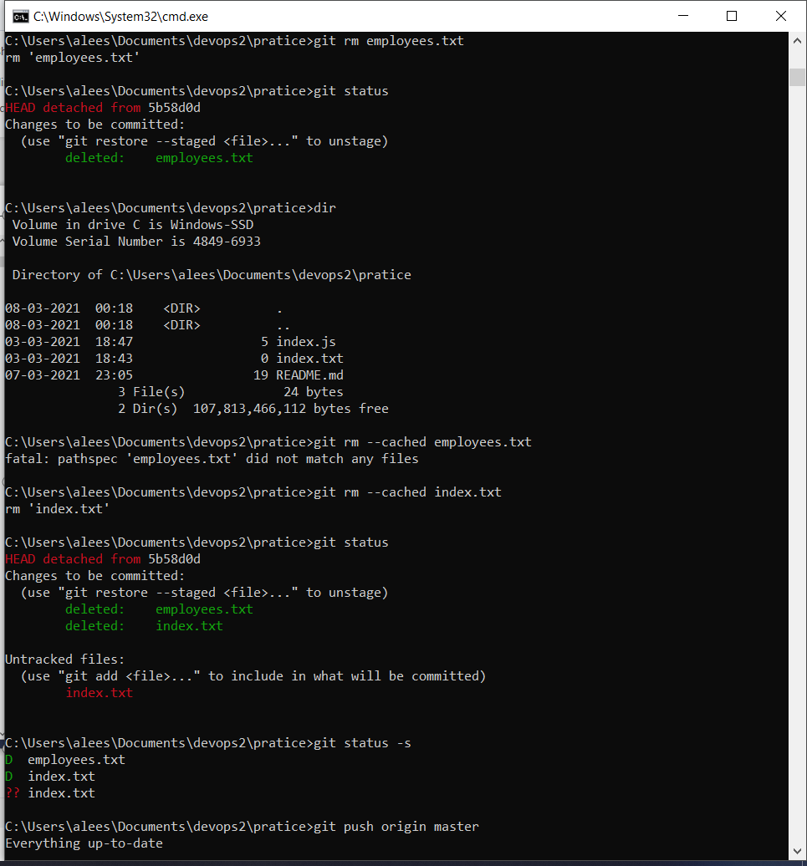
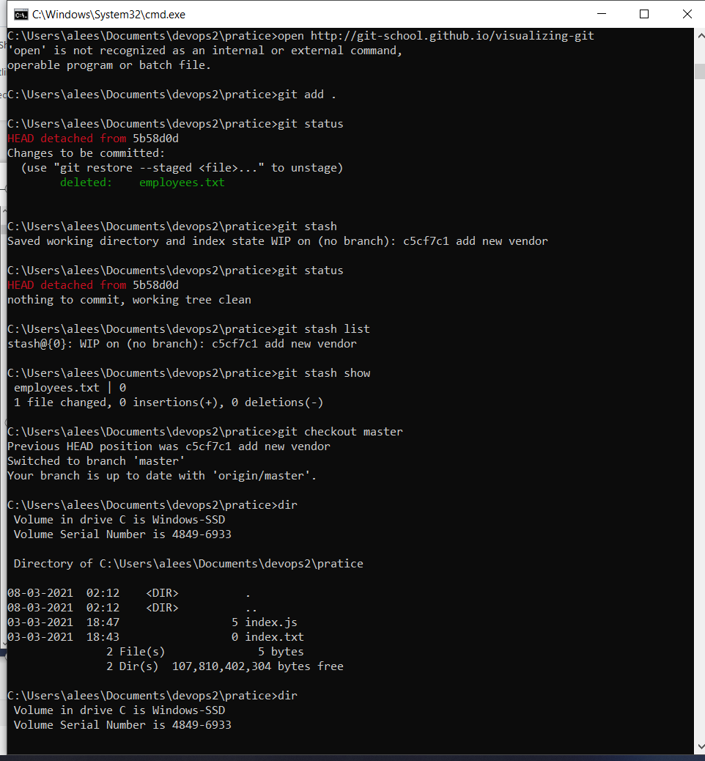

Slide 9
GIT BRANCHING
In Git, branches are a part of your everyday development process.
Git branches are effectively a pointer to a snapshot of your changes. When you want to add a new feature or fix a bug—no matter how big or how small—you spawn a new branch to encapsulate your changes. This makes it harder for unstable code to get merged into the main code base, and it gives you the chance to clean up your future's history before merging it into the main branch.
some examples to git branching are shown here.

Slide 10
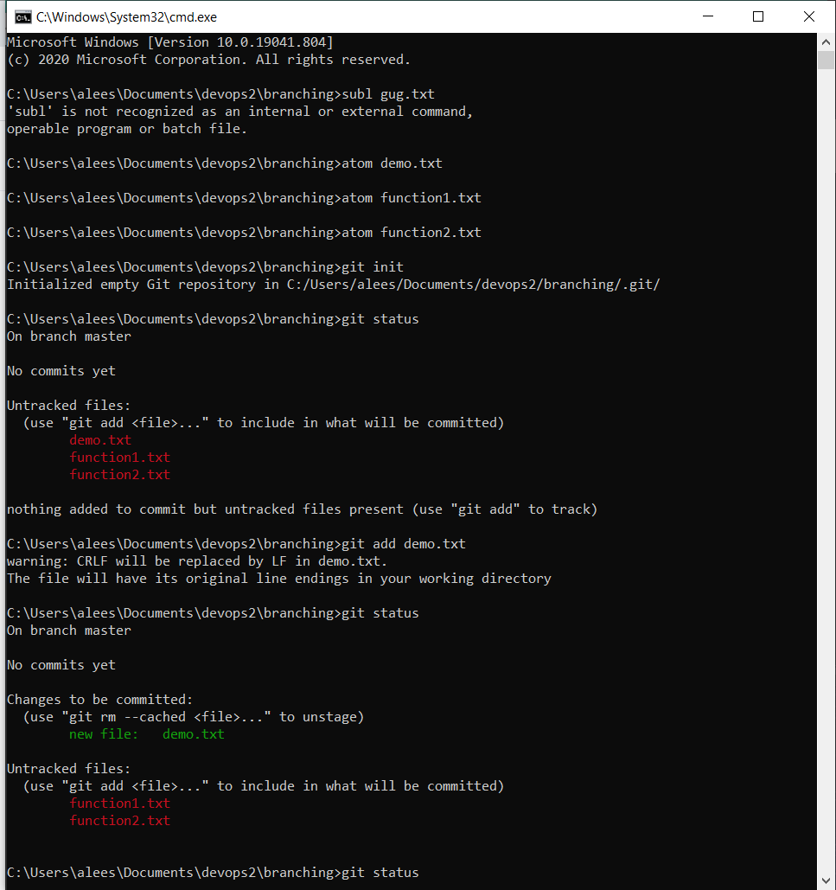
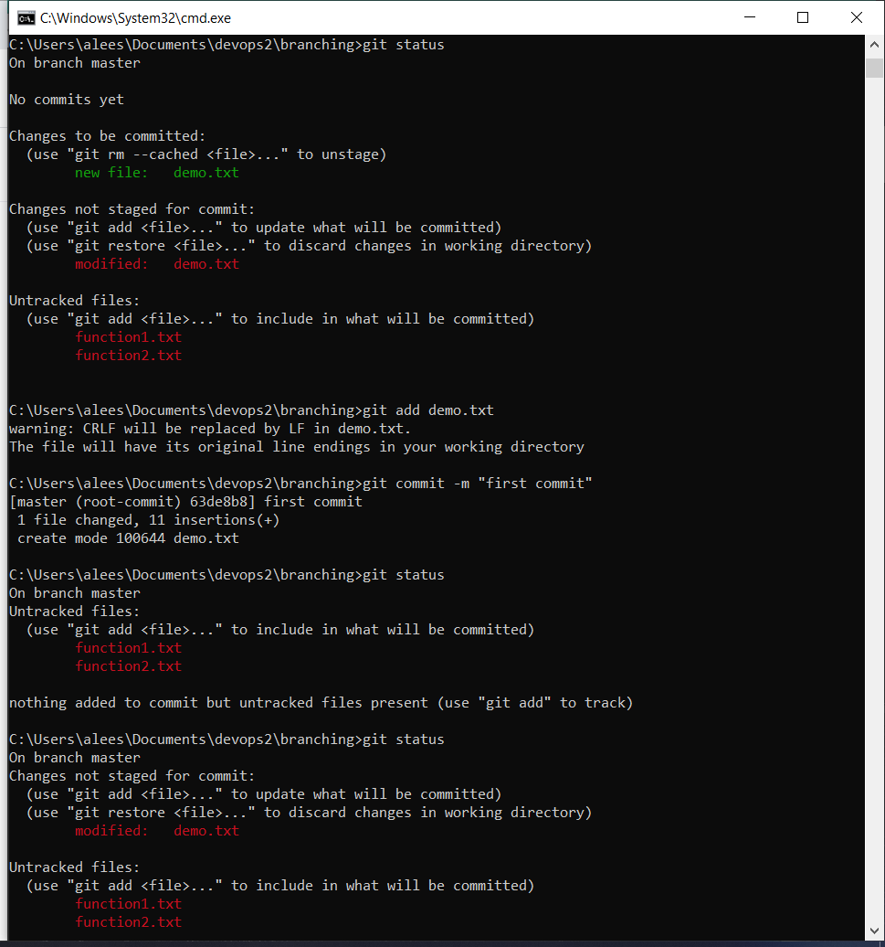

Slide 11
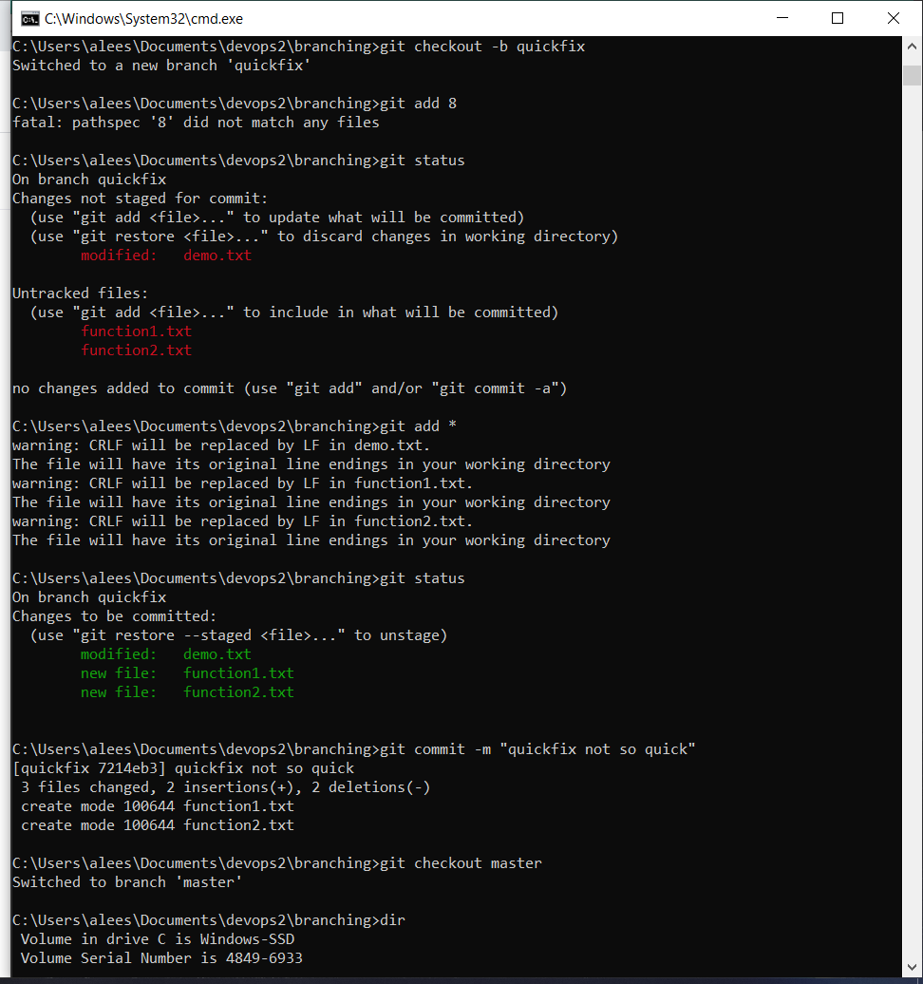
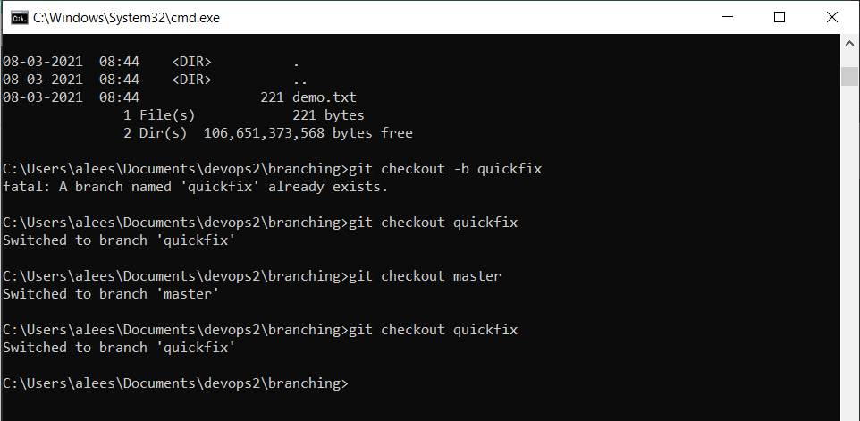
git add *:
giT checkout -b quickfix:
git checkout quickfix:
git checkout master:

Slide 12
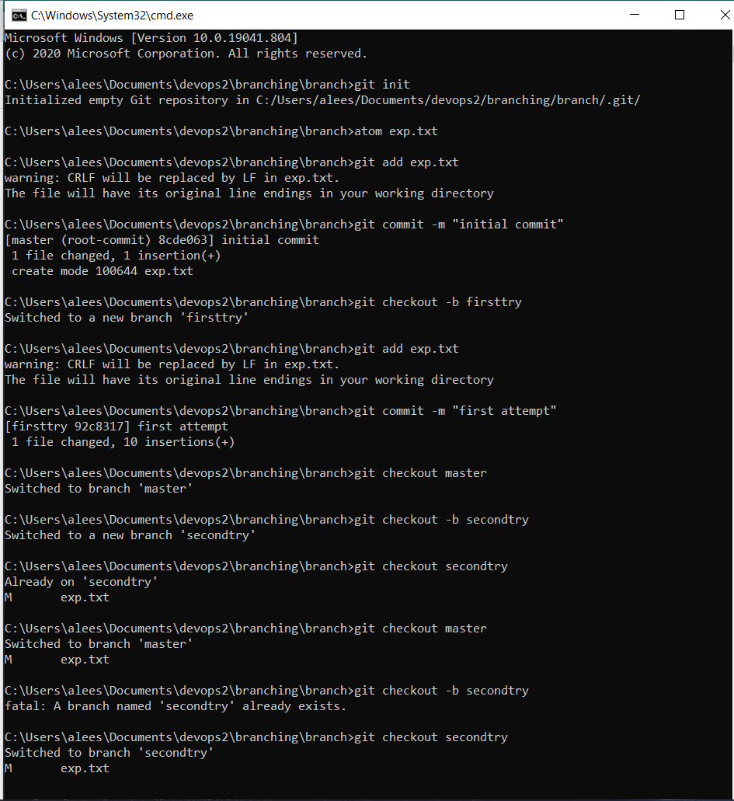
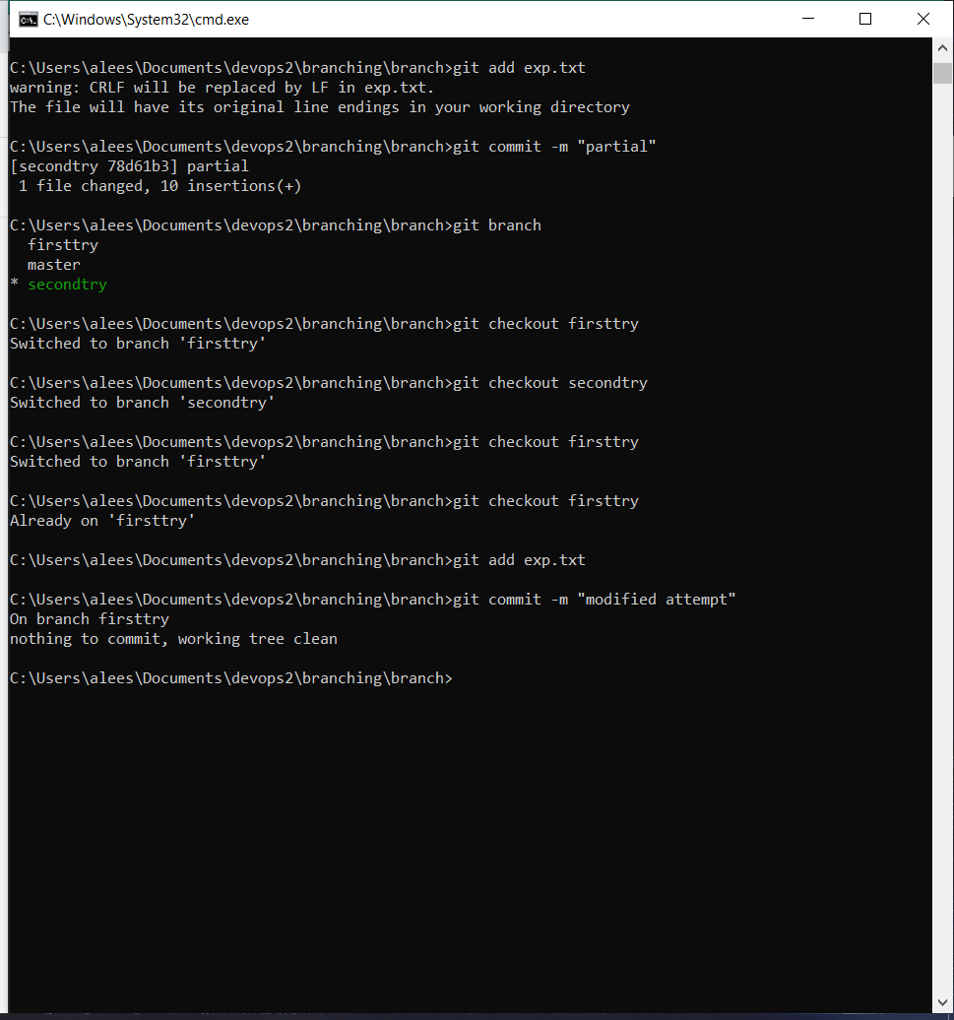

Slide 13
THANK YOU

